Slide 1
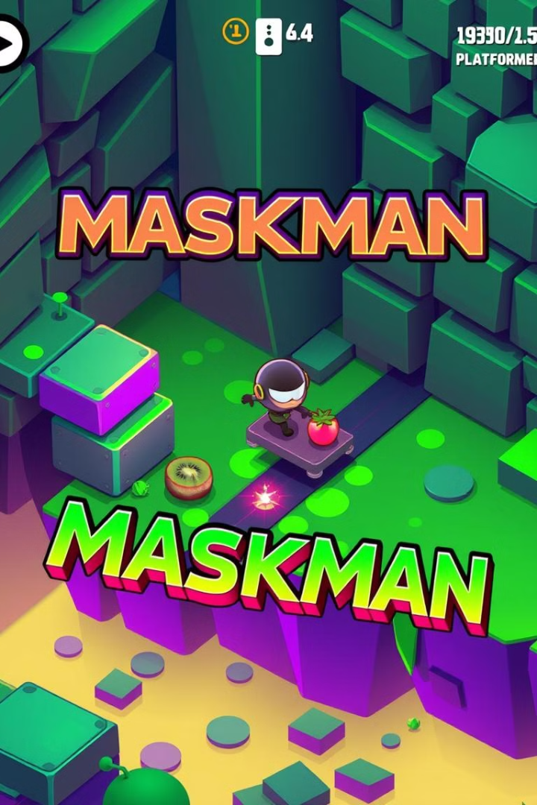
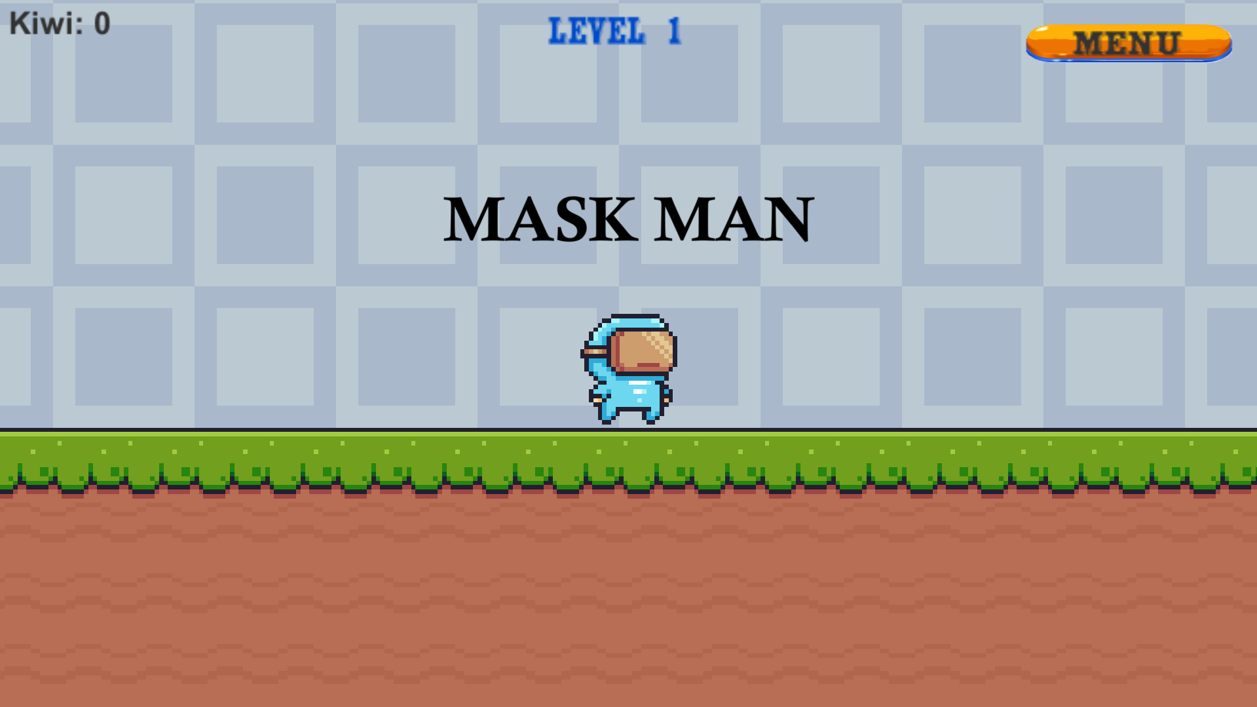
Maskman: Developing a 2D Platformer in Unity with C#
This presentation outlines the development of "Maskman," a 2D platformer game using Unity and C#. We'll cover building core game mechanics in C#, and designing engaging levels.
Key features include character movement, traps, collectibles, and score tracking. Let's dive into the world of "Maskman!"

Slide 2

Setting Up the Unity Project
New Project
Asset Import
Project Settings
Start with Unity's 2D template. This provides a basic setup for 2D game development.
Import sprites and tilemaps. These are essential for visual elements.
Configure resolution and aspect ratio for the desired look and feel.

Slide 3
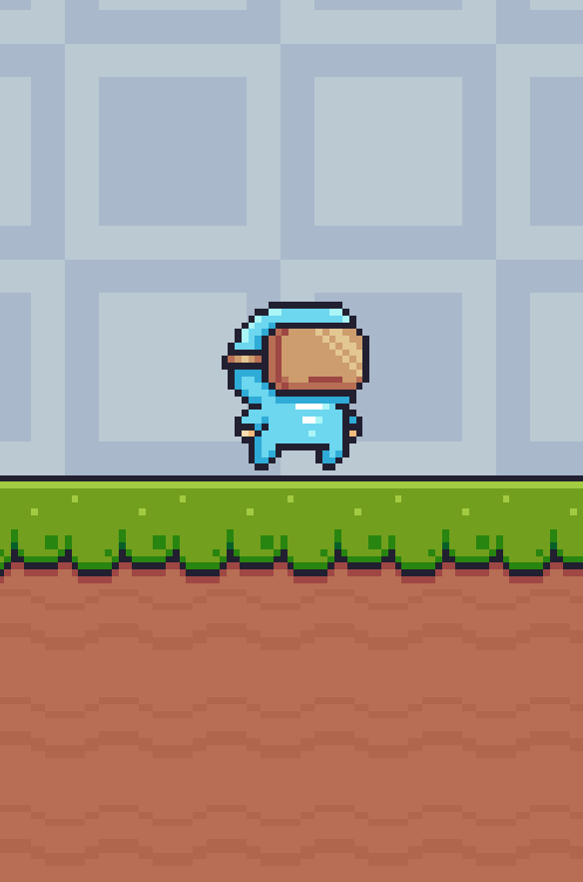
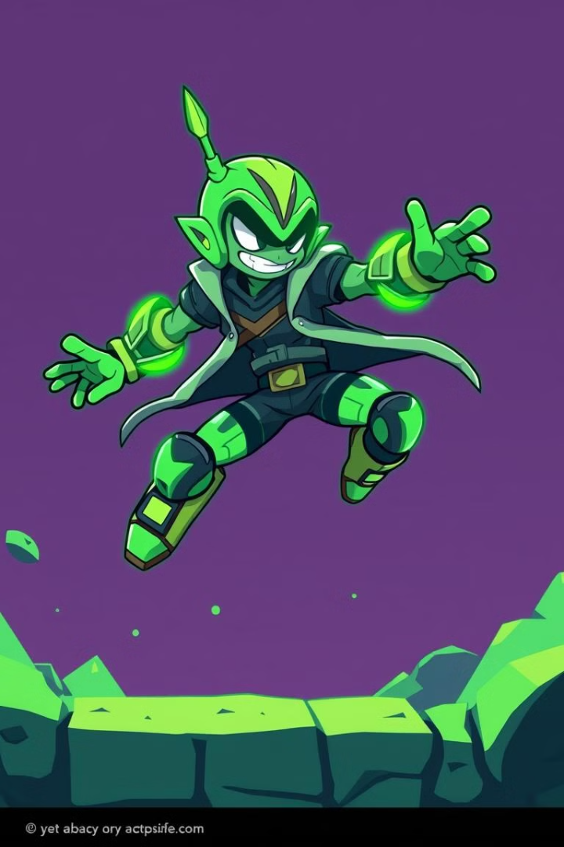



Player Movement: Jumping and Basic Physics
C# Script
Implement movement using C#.
Character Controller
Use CharacterController for collisions.
Jump Force
Apply upward force with Rigidbody2D.
Fine-tune jump height and gravity for optimal player experience.

Slide 4
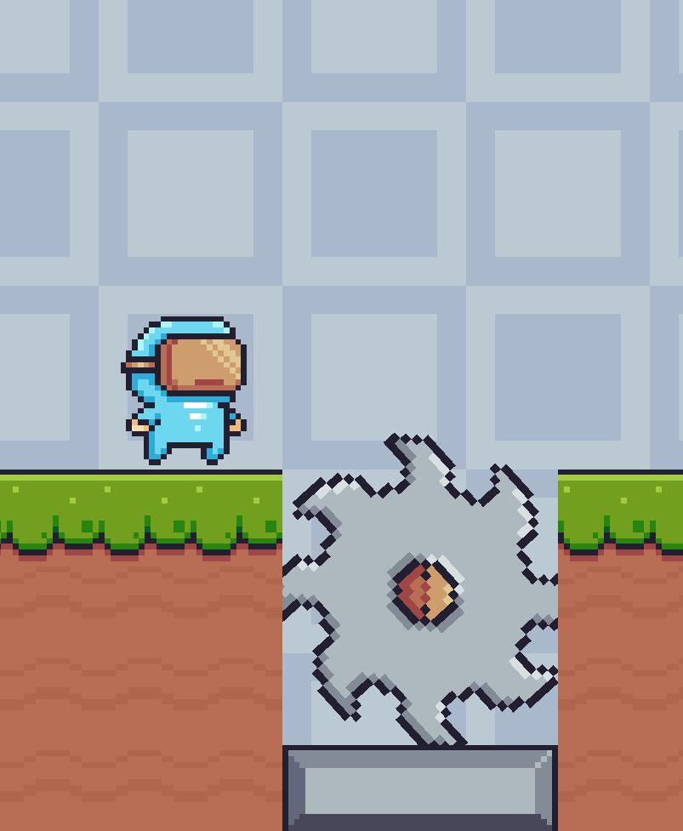
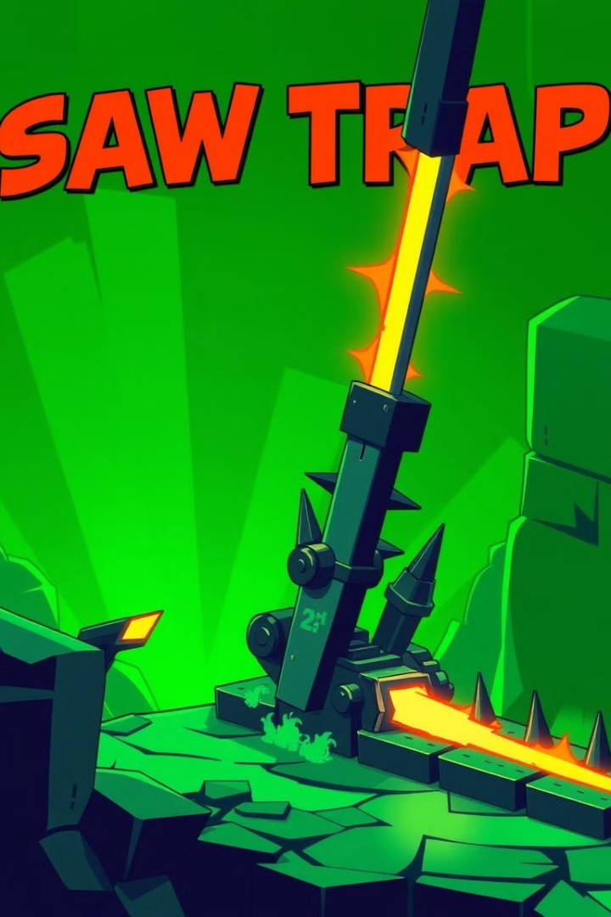
Designing Traps: Saws and Spikes
Saw Traps
Spike Traps
Rotating sprites with colliders.
Static sprites with colliders.
C# Behavior
OnTriggerEnter2D detects collisions.
Apply damage to the player upon contact. Use a health system.

Slide 5



Implementing Collectibles: Kiwi Fruit
2
Colliders
Add colliders for interaction.
Kiwi Sprites
1
Create sprites and prefabs.
C# Script
3
Destroy(gameObject); score++;
Display the score in the UI during gameplay. Track player progress.

Slide 6

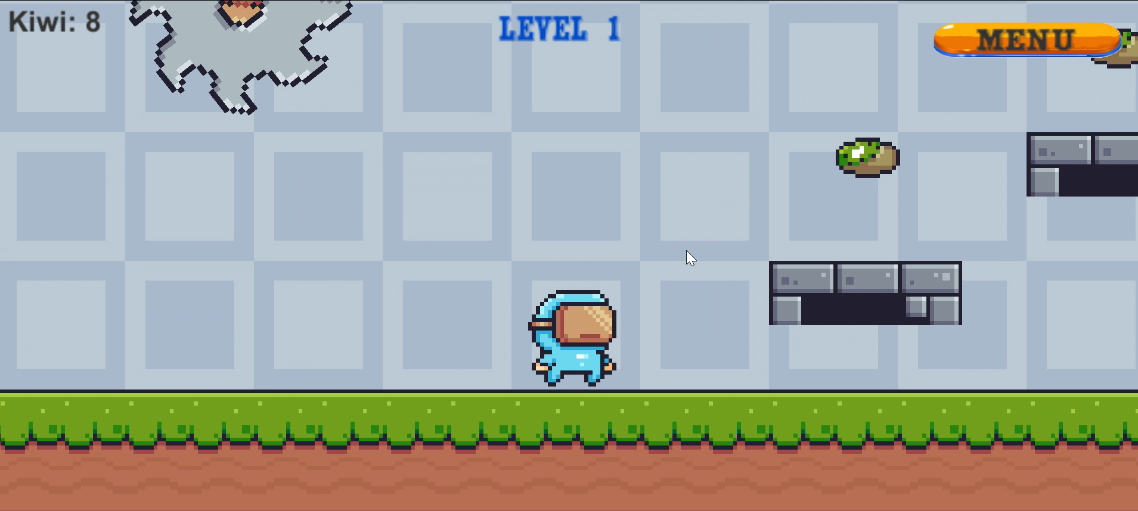



Camera Follow Script
Cinemachine
Setup package
Brain
Attach to camera
Boundaries
Configure camera limits
Smooth camera movements enhance the player experience. This creates a more professional feel.

Slide 7
Level Design with Tilemaps
1
Tilemap System
2
Level Layouts
3
Optimization
Design levels with platforms, traps, and collectibles. Optimize tilemaps for performance.

Slide 8
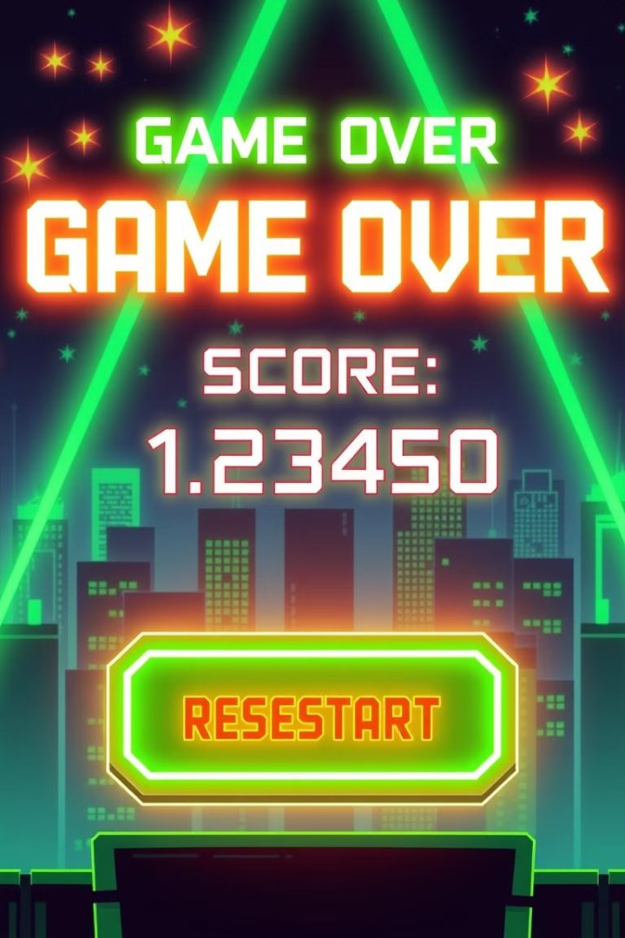
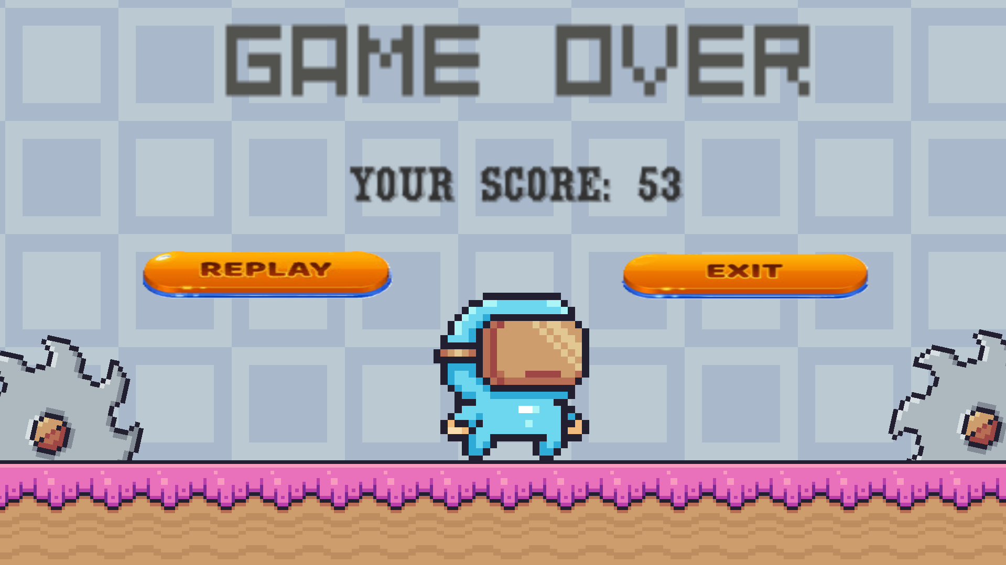
Building the End Screen
New Scene
Final Score
Create end screen scene.
Display score with UI system.
Restart Button
SceneManager.LoadScene.
Implement high score tracking (optional). Allow players to save their progress.

Slide 9

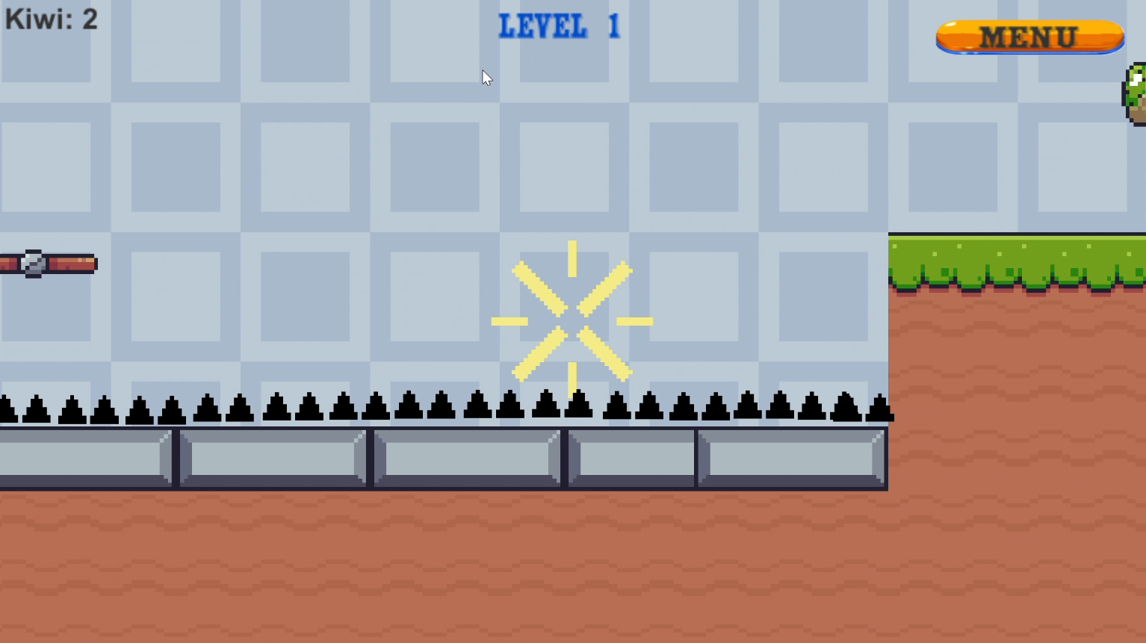
Sound Effects and Polish
3
1
Actions
Audio Source
Jumping, collecting, dying
Component usage
Fine-tune game feel with particle effects and animations. Considerations for different audio file types.

Slide 10
Conclusion: Maskman - From Concept to Platformer
Key Concepts
Next Steps
Movement
New features
Traps
New levels
Collectibles
New enemies
Scoring

